Slide 1
Computational Thermal Engineering
GROUP Project - 1 : Creating a new OpenFOAM solver based on icoFoam
DAY 11
Kumaresh Selvakumar

Slide 2
Group Project
Copy default icoFoam solver
Adding the temperature field in the icoFoam solver
Copy default cavity tutorial based from icoFoam
Add a new file for initial and boundary conditions
Add respective files in fvSchemes and fvSolution
Run your new case file
Upload your new solver, case files, and results in GITHUB

Slide 3
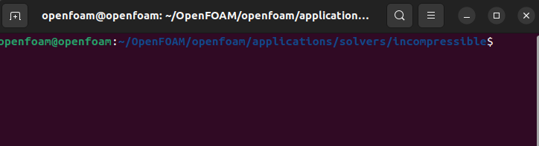
Copy default icoFoam solver
From the location:
To make your own solver, firstly do the following:
Change the default icoFoam name into myIcoFoam.
Change the source file name from icoFoam.C into myIcoFoam.C
Open Files, and do the following:
myIcoFoam.C
EXE = $(FOAM_USER_APPBIN)/myIcoFoam

Slide 4
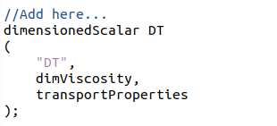
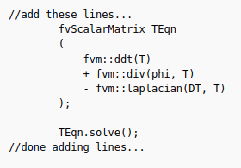
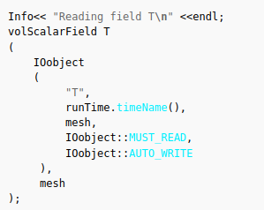
2. Adding the temperature field in the icoFoam solver
Under createFields.H
Under myIcoFoam.C

Slide 5
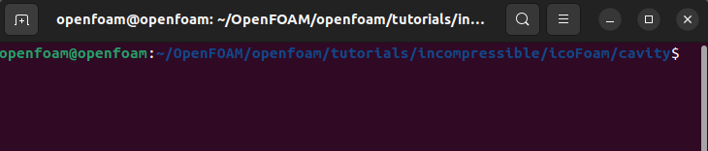
3. Copy default cavity tutorial based from icoFoam
From the location:
Modify your solver name as myCavityCaseFile

Slide 6
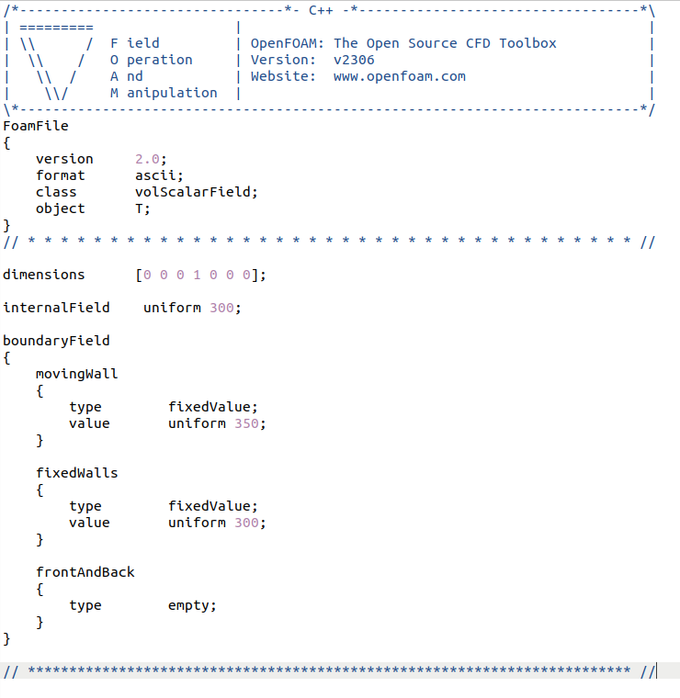
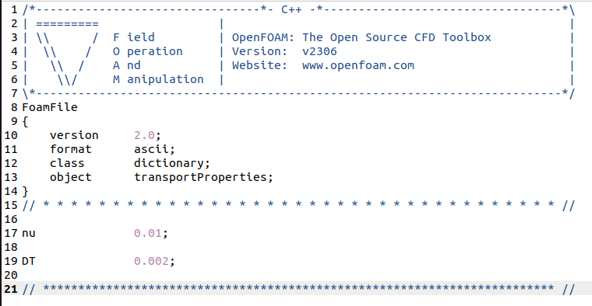
4. Add a new file for initial and boundary conditions
Under constant/transportProperties
Add DT (new variable created)
Add “T” field in “0” file

Slide 7
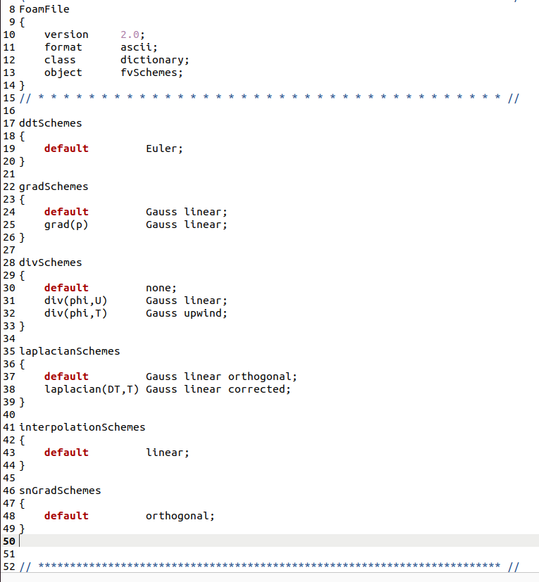
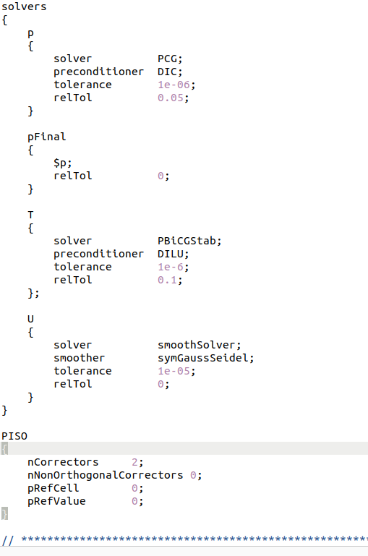
5. Add respective files in fvSchemes and fvSolution
Under system/fvSchemes
Under system/fvSolution

Slide 8
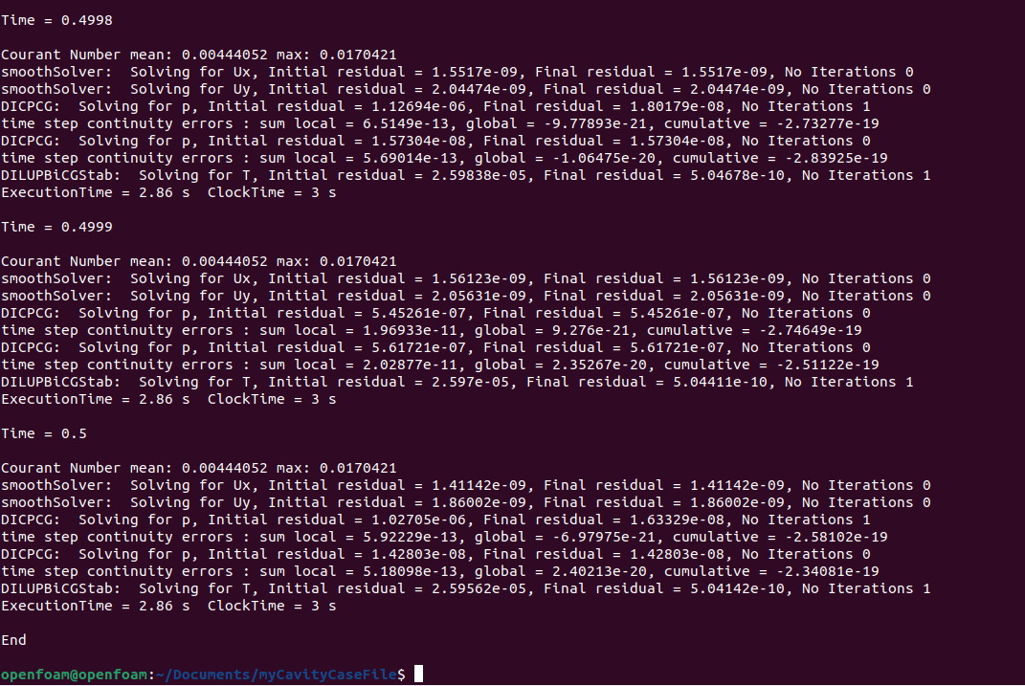
6. Run your new case file

Slide 9
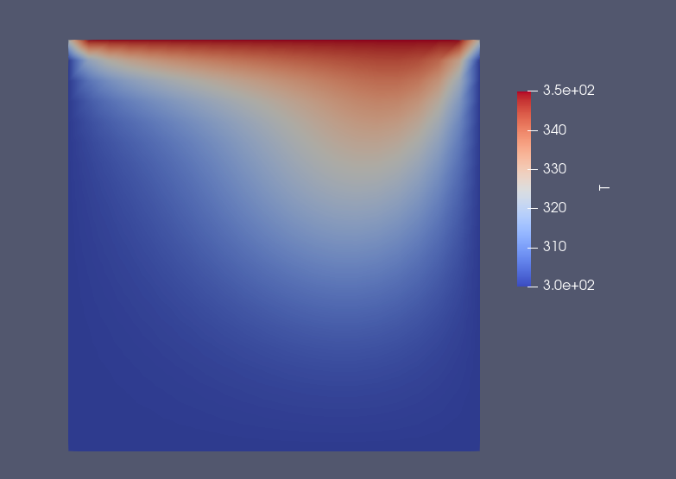
7. Upload your new solver, case files, and results in GITHUB

